Slide 1
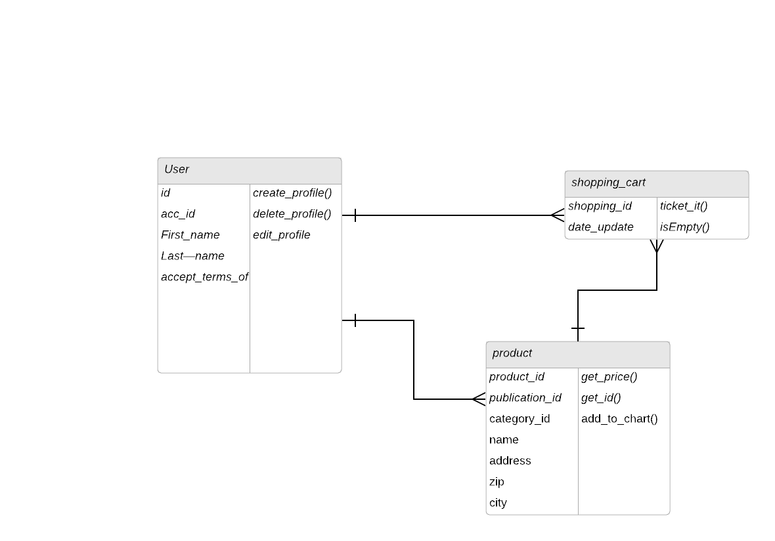
02.01 Add desired item to cart

Slide 2
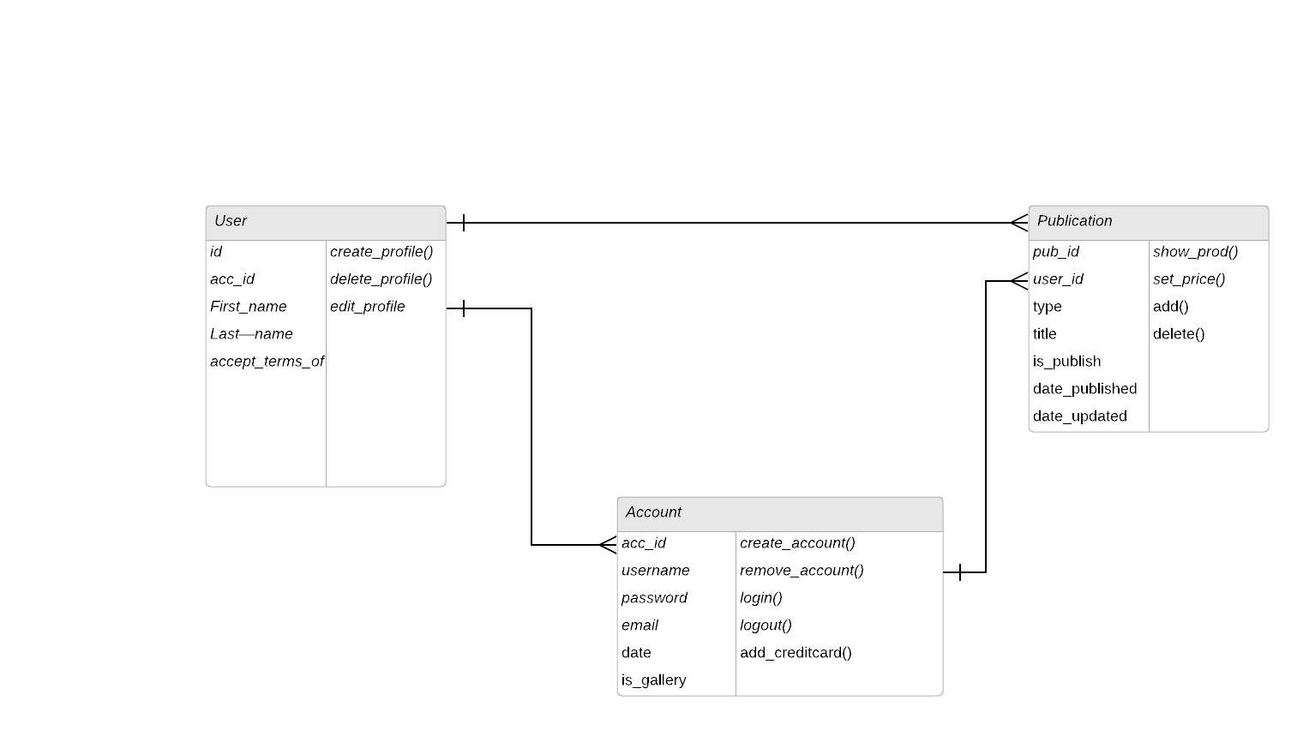
02.02 update Stock inventory

Slide 3
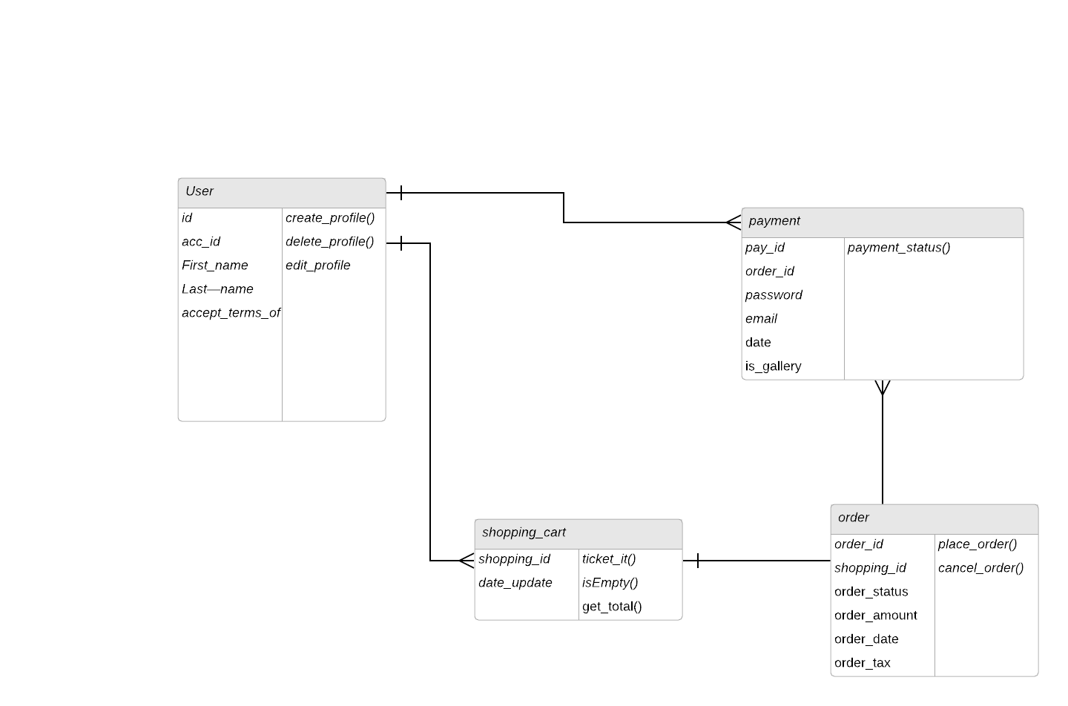
02.03 options to checkout

Slide 4
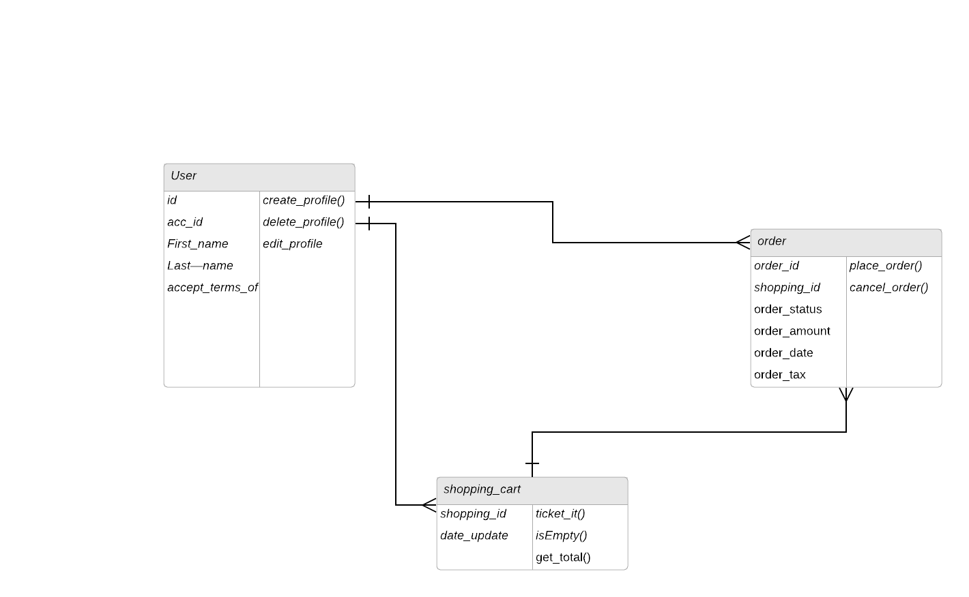
03.01 Total cart value at check out

Slide 5
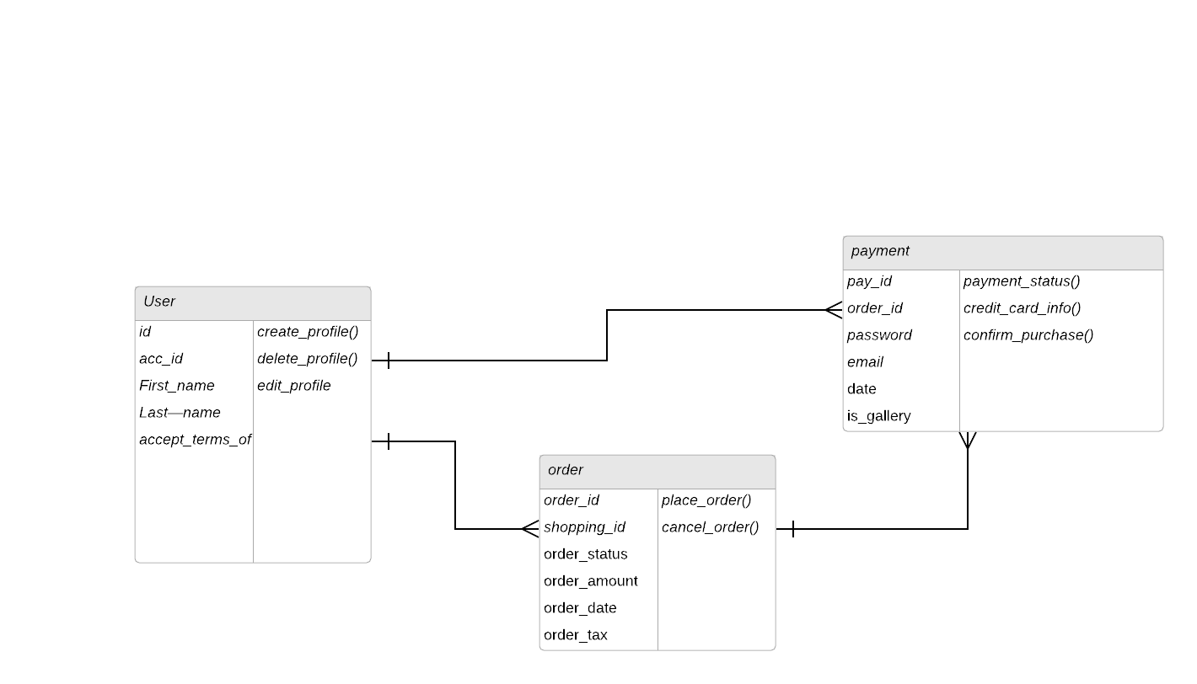
03.02 Enter credit card Info

Slide 6
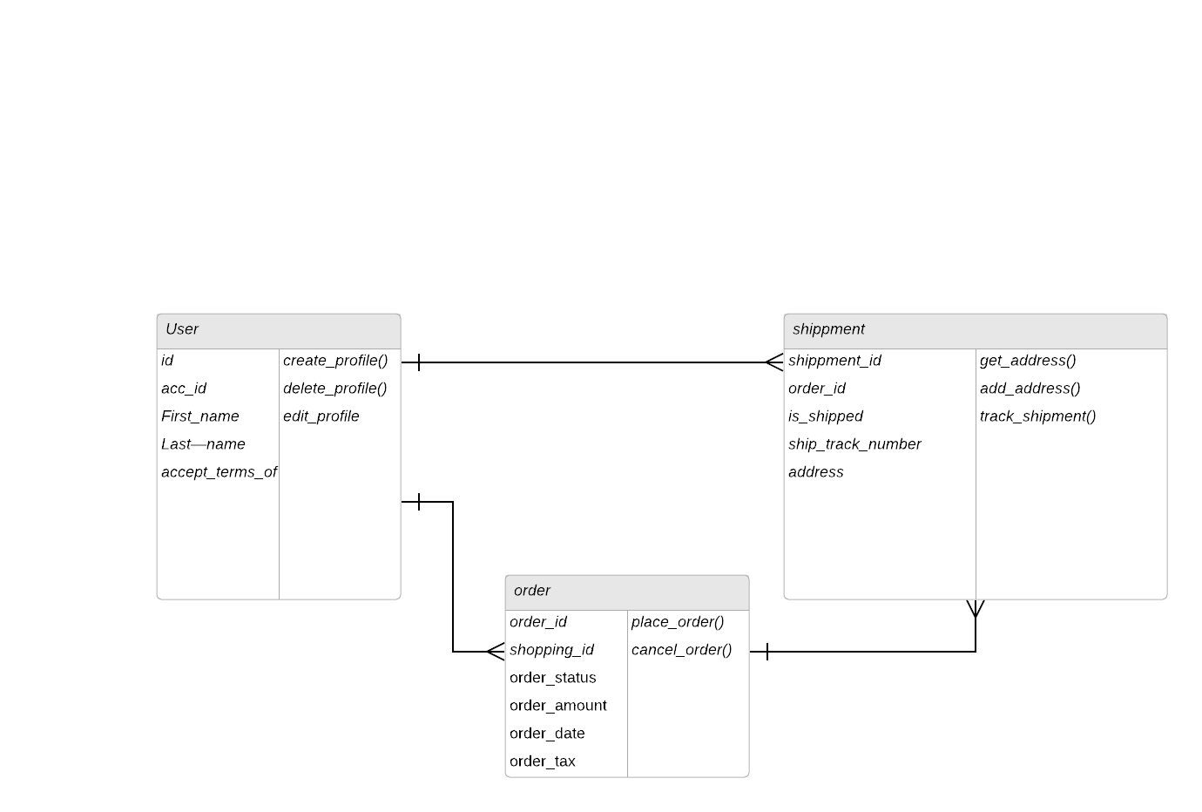
03.03 Enter mailing info

Slide 7
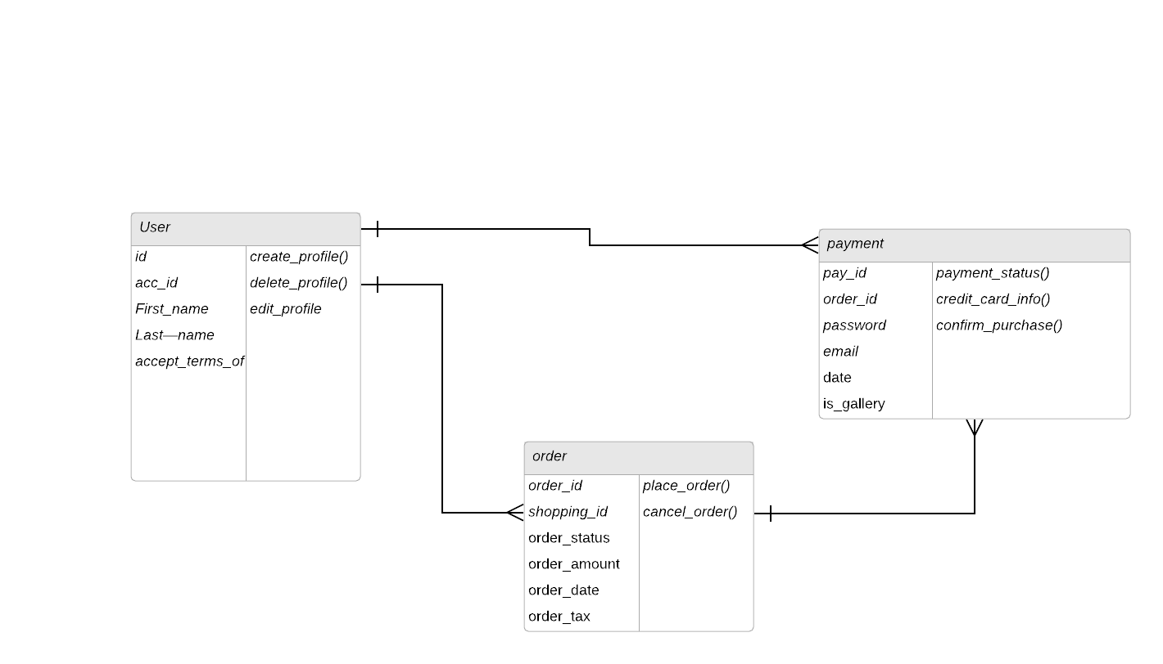
03.04 confirm purchase

Slide 8
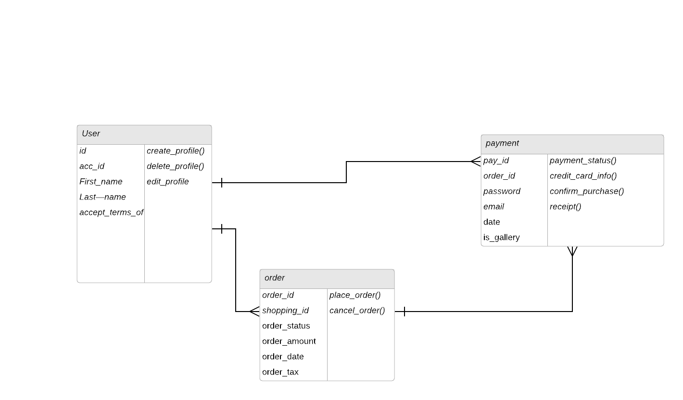
03.05 order receipt generated

Slide 9
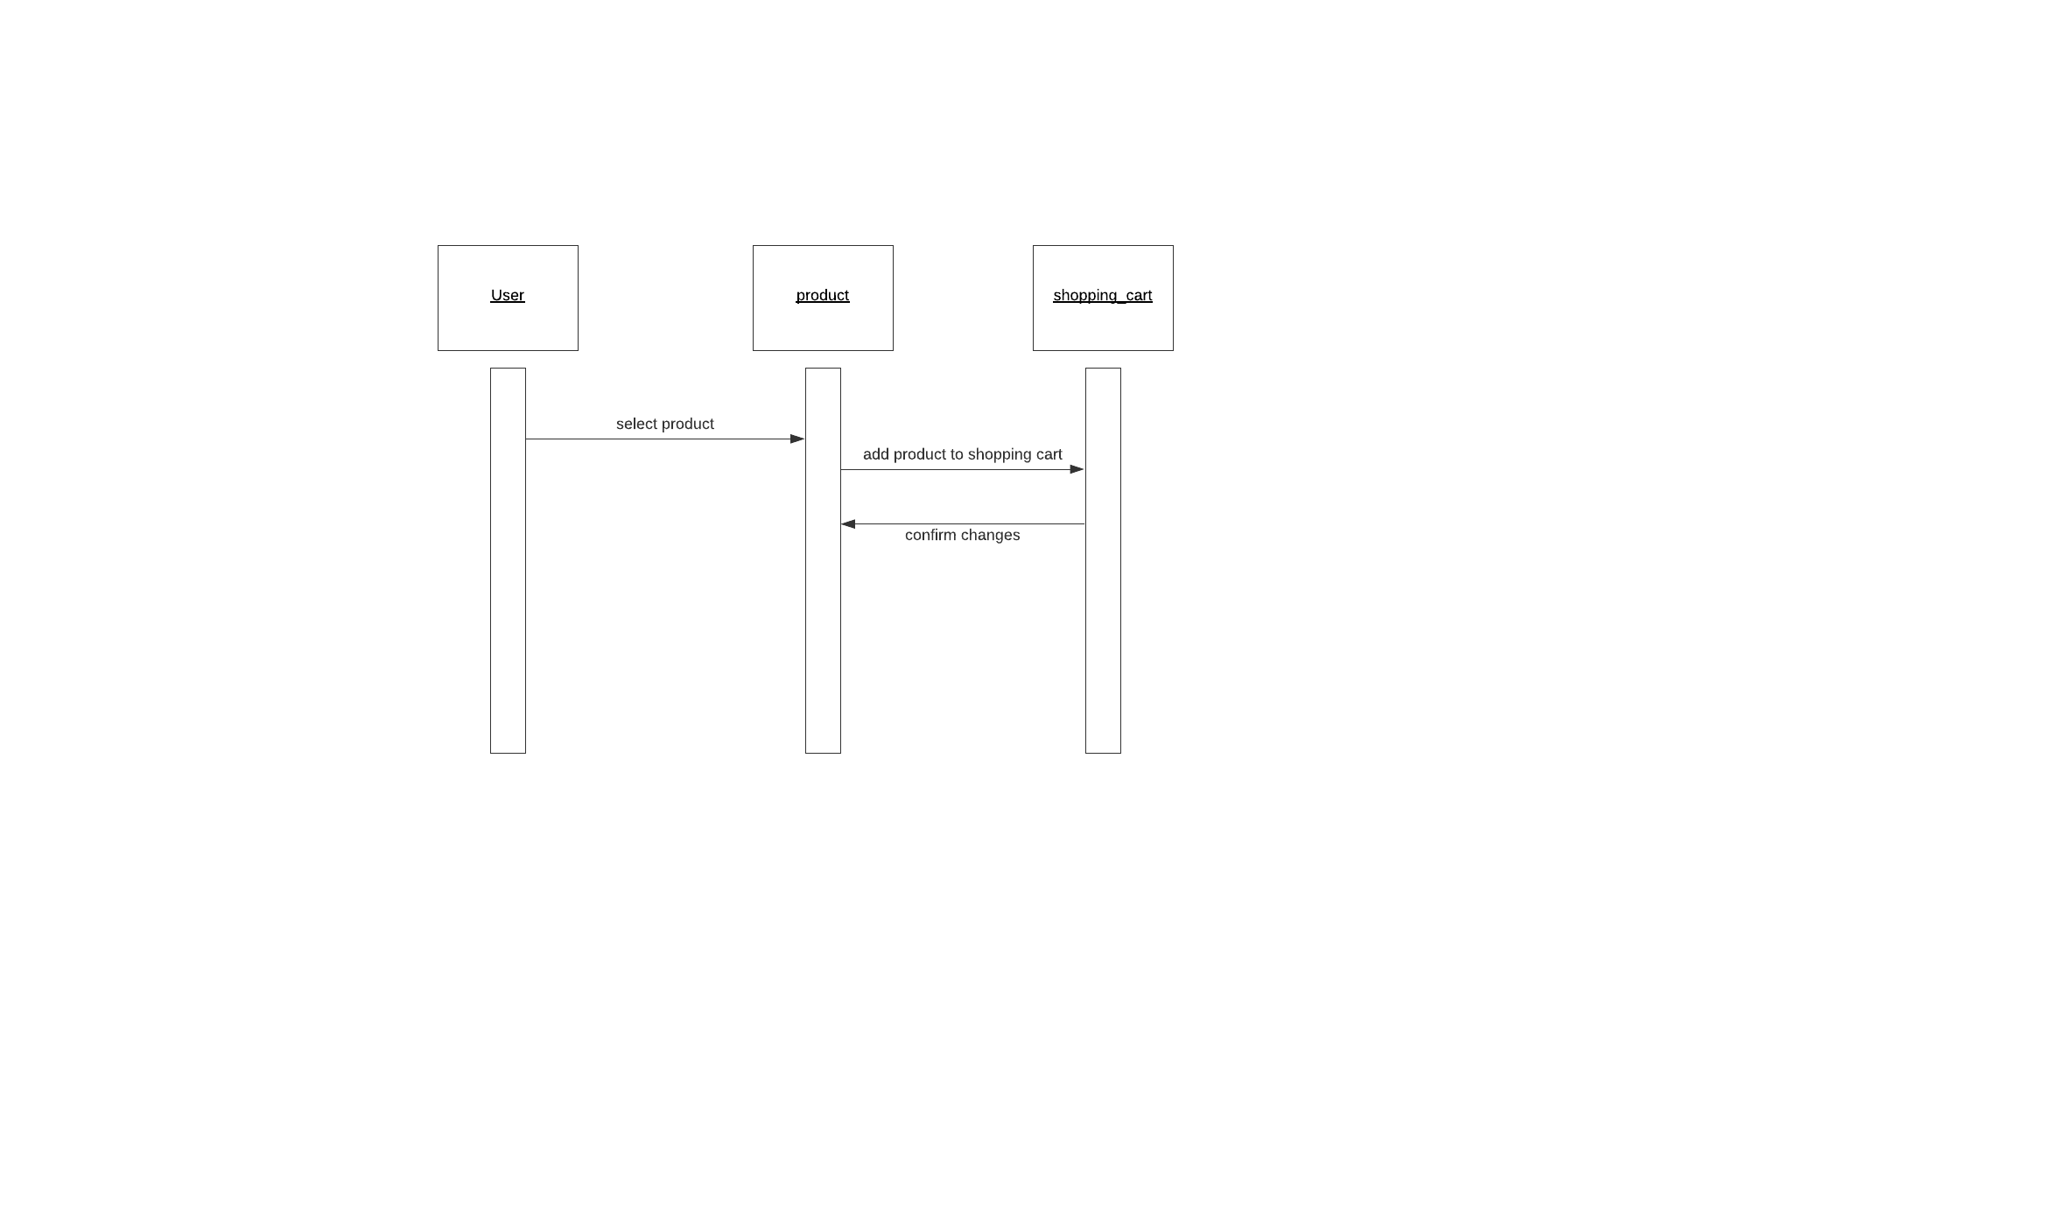
02.01 Add desired item to cart

Slide 10
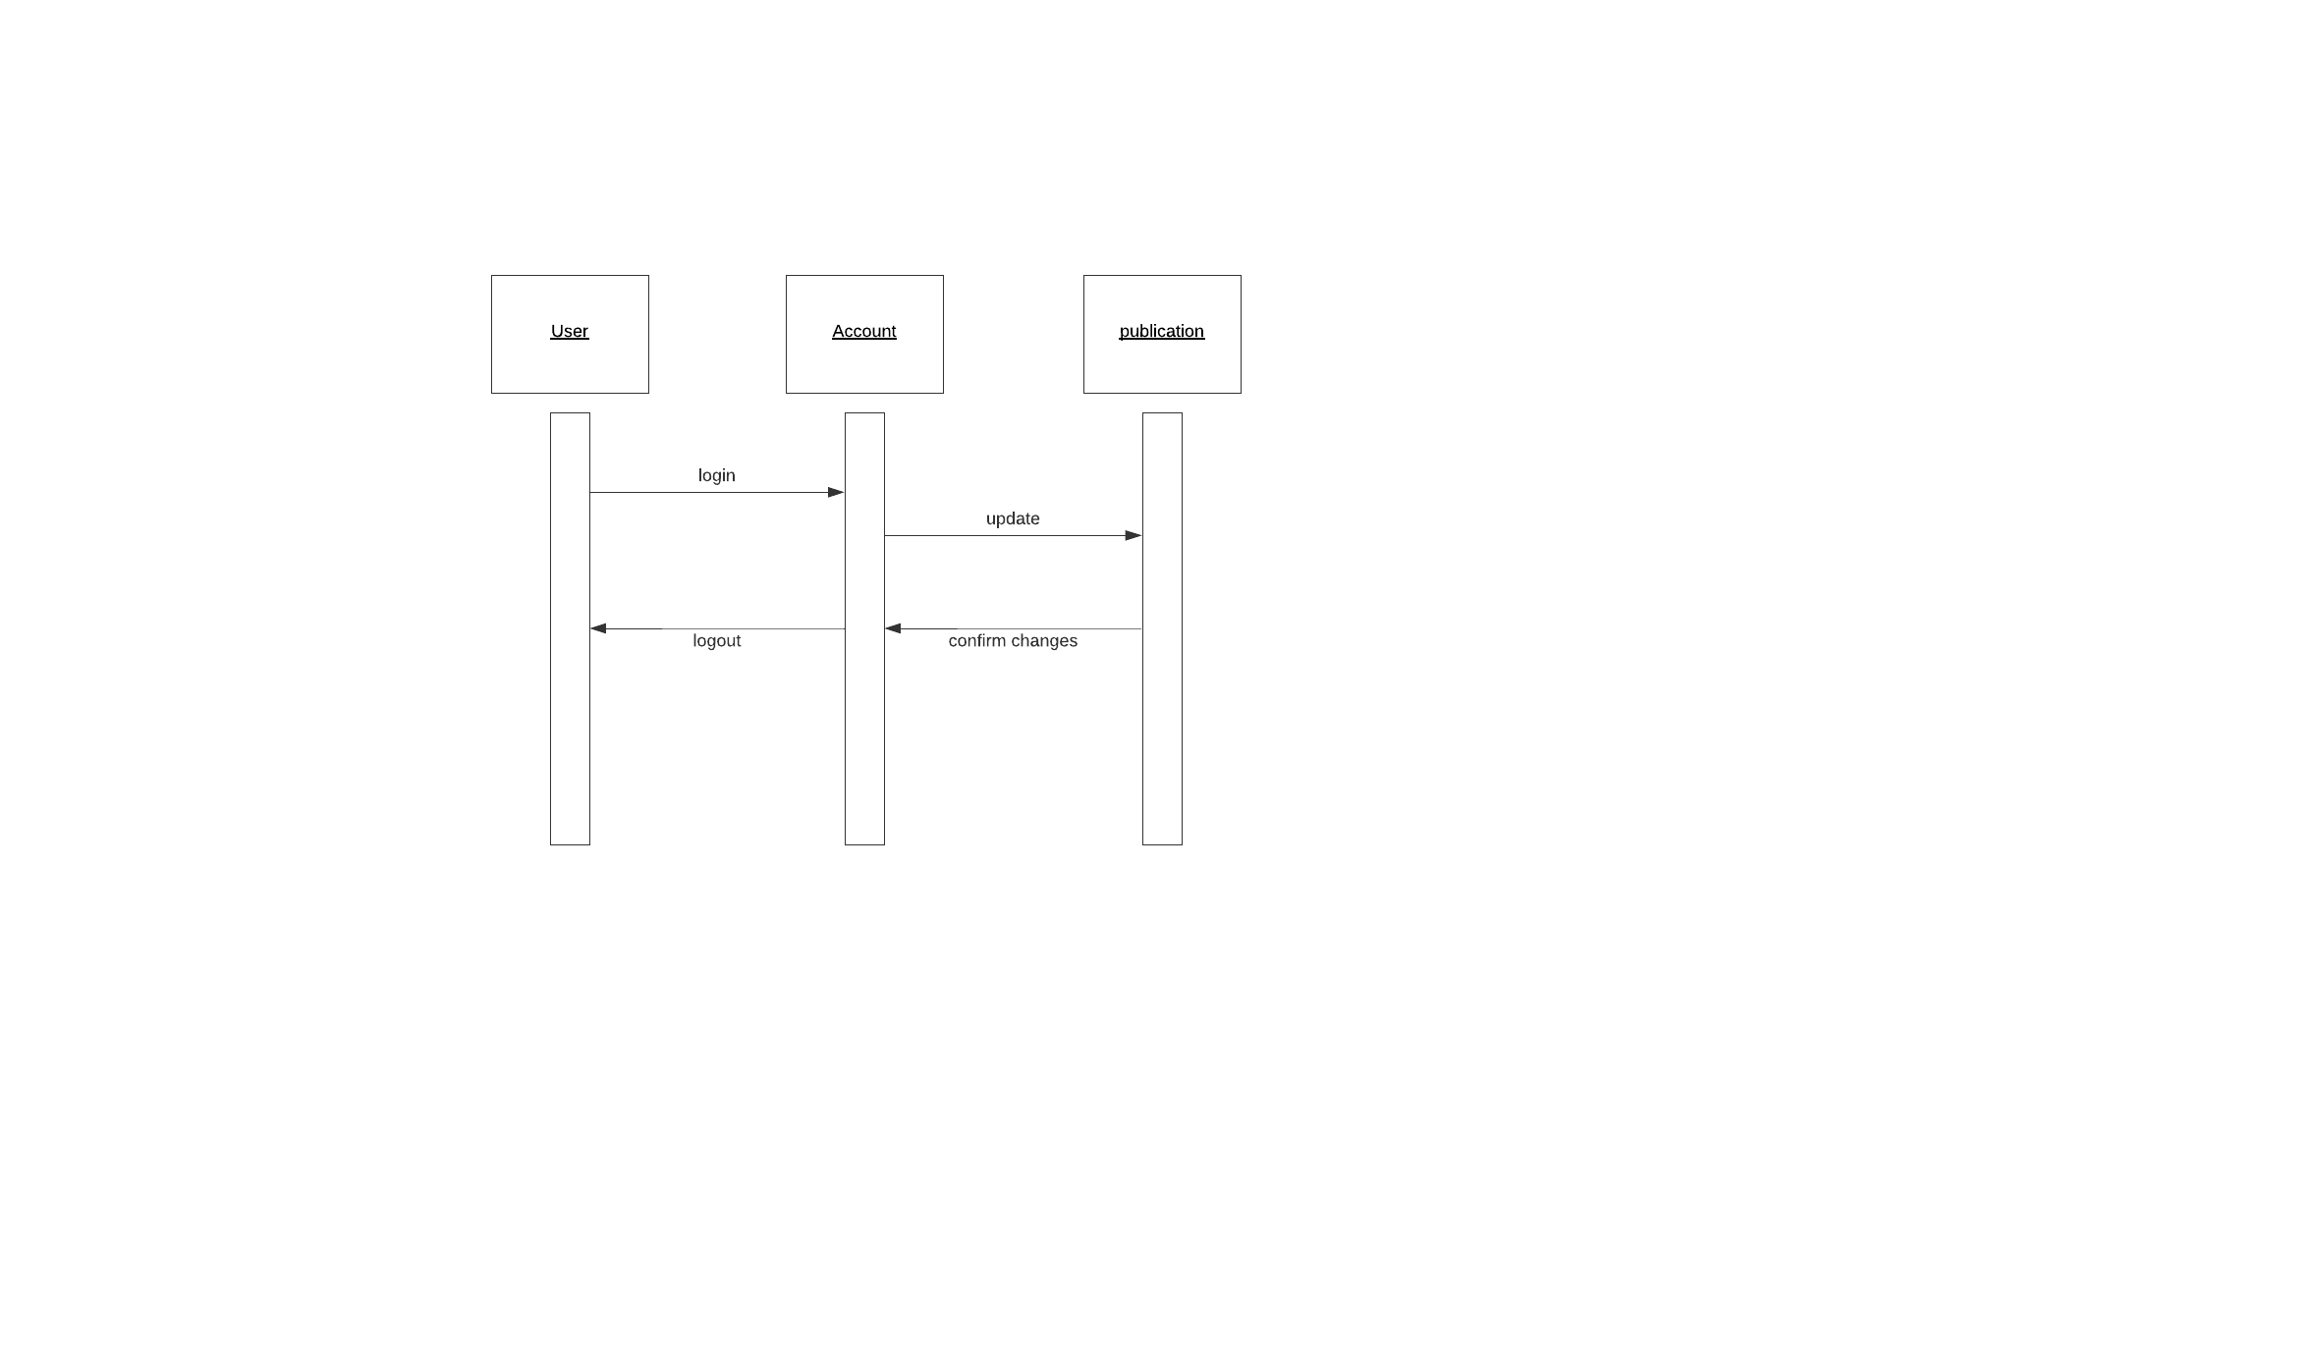
02.02 update Stock inventory

Slide 11
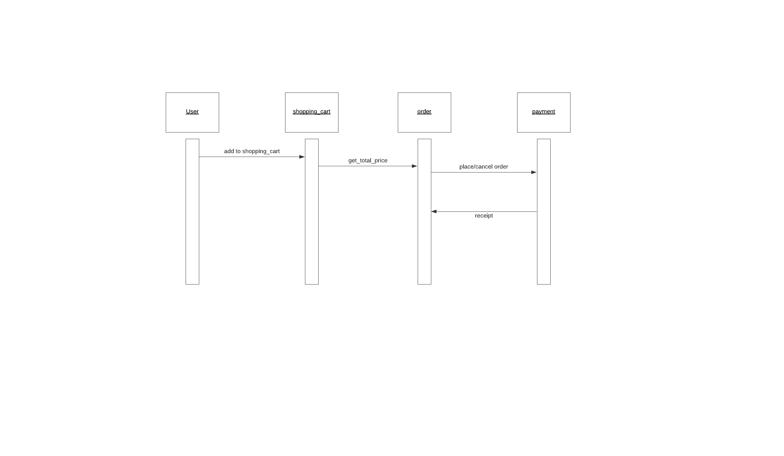
02.03 options to checkout

Slide 12

03.01 Total cart value at check out

Slide 13
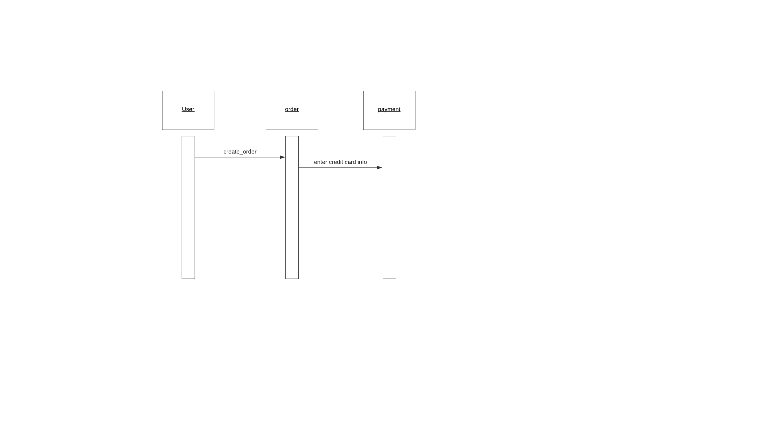
03.02 Enter credit card amount

Slide 14

03.03 Enter mailing info

Slide 15
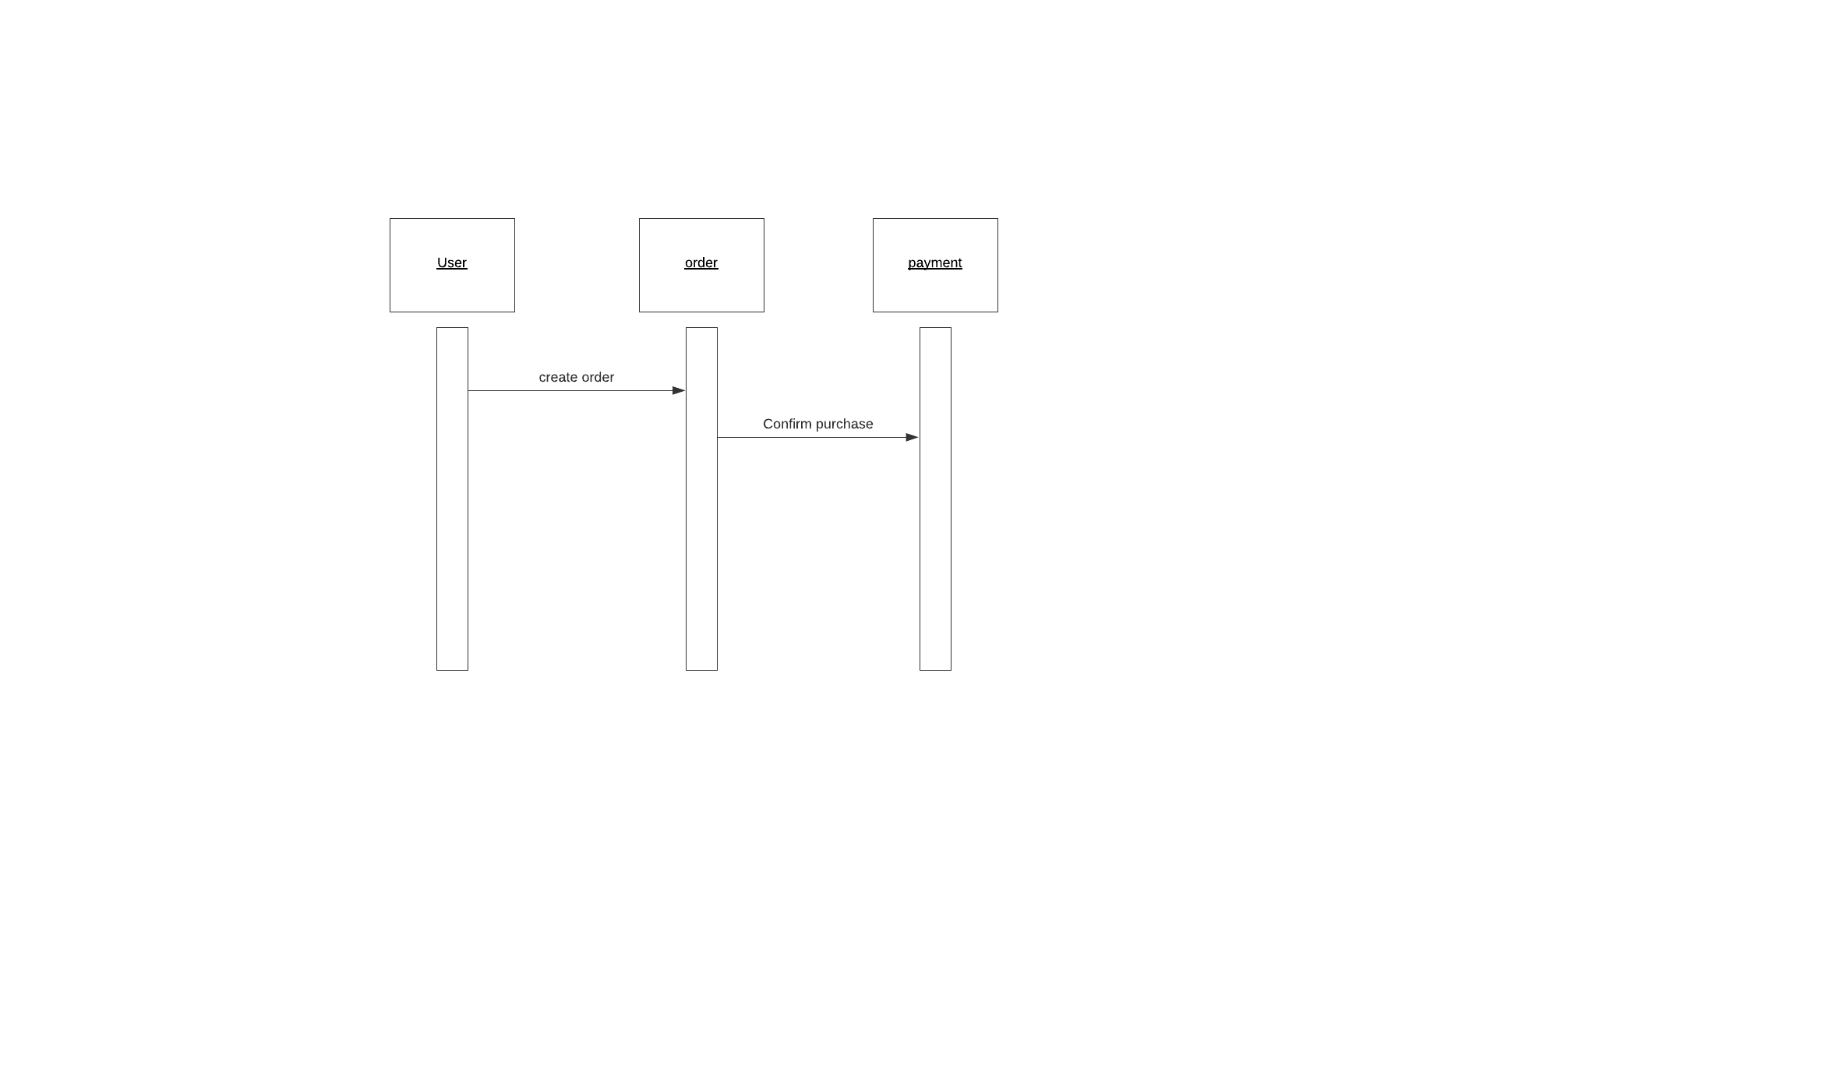
03.04 confirm purchase

Slide 16
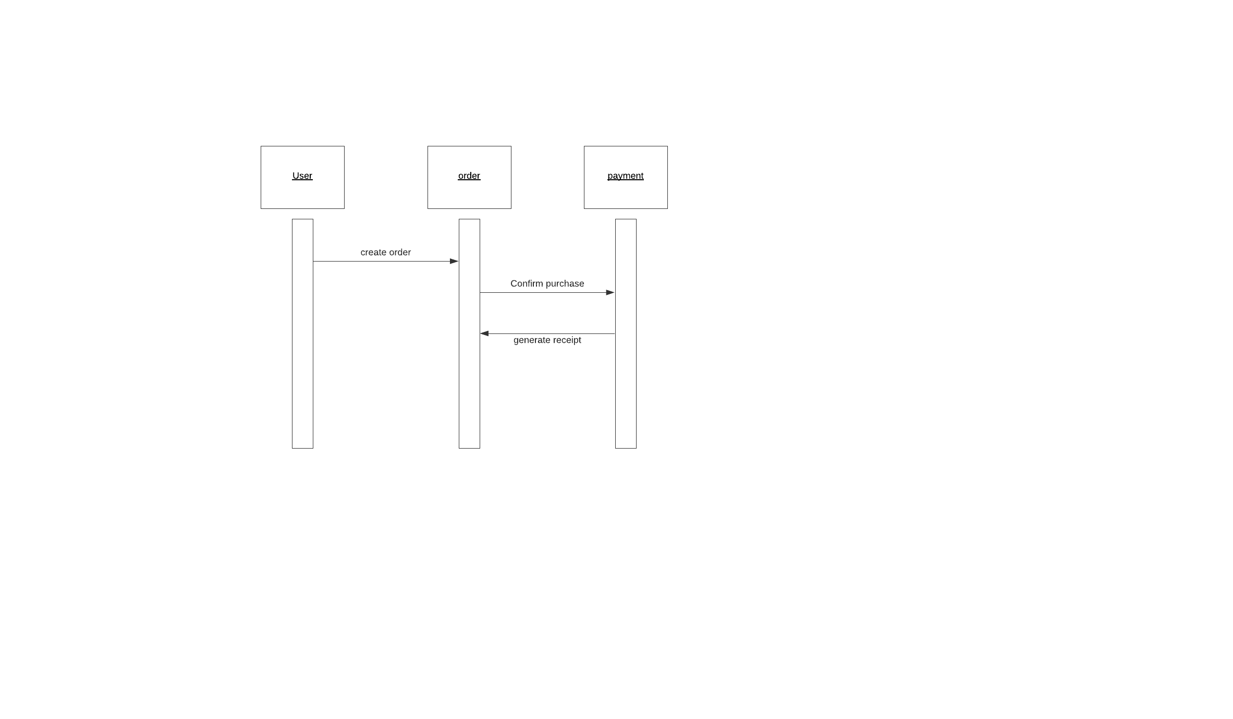
03.05 generate receipt

